Slide 1
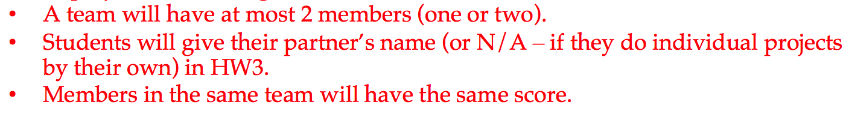
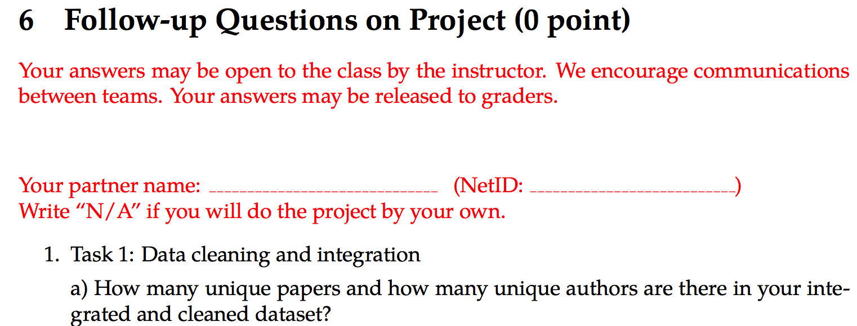
Announcement
Individual Team project! (Respect Notre Dame’s teamwork tradition: This is why Fighting Irish is strong?) – voting result
Project instruction [updated]:
HW3 [updated]:

Slide 2
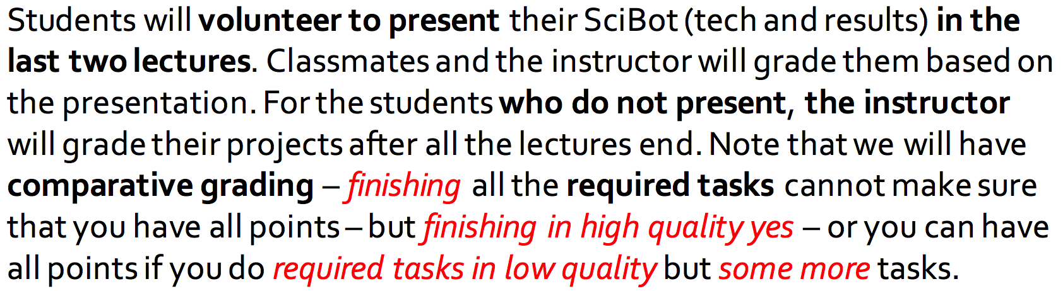
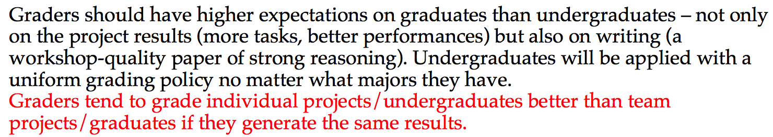
Announcement (cont.)
Comparative grading
Project… Traditional open-style grading will be more subjective.
Project introduction slides [updated]:
Project instruction [updated]:

Slide 3
PRINCIPLE
Enable more interesting, powerful
features for your SciBot!!!
Surprise graders!

Slide 4
My Grading Could Be…
 |  | Time
Task 1 | Cleaning and Integration | 10 mins
Task 2 | Entity name candidate generation | 20 mins (Abbreviation or Capital-case rules) | +40 mins (Apriori)
 | Entity name quality assessment | 10 mins (support + 2-gram sig.) | +20 mins (n-gram sig.)
Task 3 | Entity typing | 15 mins (majority voting) | +40 mins (clustering+typing) OR (pattern-based typing)
Task 4 | Collaboration discovery | 20 mins (FP-Growth) | +5 mins (Kulc for 2-itemsets)
 |  | 75 mins | +105 mins = 180 mins = 3 hours
Grading |  | A, B+, A-, B+, A- | A, A, A, A, A
 | × (professor/student): 0.5 to 3.0 | 38 mins – 3h 45mins | 1h 30mins – 9 hours

Slide 5
My Response to Mid-Semester Survey
Can we do teams please!
A: Yes! Go Irish!
Comparative grading: Extra credit should be awarded for additional tasks but 100% should be given if the 7 tasks are satisfactorily completed – my answer: Yes!
Q: Except for the basic 7 tasks, how many other tasks will each student does on average (according to your past experience)? I am afraid I don’t have enough time to complete too many alternative tasks.
A: 1 to 3 (UIUC) if the 7 were not satisfactorily completed in students’ self-evaluation.
The only concern I have is that it seems really long and tedious.

Slide 6
My Response to Mid-Semester Survey
Ultimate goals, Clarity on what need to know for tests
Slow down a little: Vocabulary, In-class explanation, Discussion and questions
Examples, details, programming example, Jupyter notebook
Organization of slides
Notes on board
More candy and Alan

Slide 7
My Response to Mid-Semester Survey
The original instructor didn’t seem to know what was necessary to cover and the lectures were disjointed and hard to follow. Now that there is a consistent structure, I feel like I am very much behind after a confusing first three weeks.
A: That’s why we have course review ☺
There should really be more office hours - the hours picked out for the TA and Prof. Jiang is not sufficient for everyone.
A: Only one student came to me at office hours ☹

Slide 8
Concrete Learning Goals
Can process raw data: data cleaning, data integration, data reduction, dimension reduction
Can describe data warehouse, OLAP, data cube concepts and technology that work on multi-dimensional datasets
Can use Apriori and FP-Growth for frequent pattern mining
Can describe diverse patterns, sequential patterns, graph patterns
Can use Decision Tree, Naïve Bayes, Ensembles for classification
Can describe SVMs and Neural Networks for classification
Can use K-Partitioning Methods (K-Means, etc.) for clustering
Can describe Kernel-based Clustering and Density-based Clustering
Can use appropriate measures to evaluate results of different functionalities

Slide 9

Course Review 1: Chapter 1 to 7
Meng Jiang
Data Science

Slide 10
Chapter 1: Introduction

Slide 11
What is Data Science?
“...the process of automatically discovering useful information in large repositories of data.” — Introduction to Data Mining (Tan, Steinbach, & Kumar)
“...the process of discovering patterns in data.” — Data Mining: Practical Machine Learning Tools and Techniques, 3rd Edition (Witten, Frank, & Hall)
“...the process of discovering interesting patterns and knowledge from large amounts of data.” — Data Mining: Concepts and Techniques, 3rd Edition (Han, Kambler, & Pei)

Slide 12
Our Definition of the Course
“...the art and craft of extracting knowledge from large bodies of structured and unstructured data using methods from many disciplines, including (but not limited to) machine learning, databases, probability and statistics, information theory, and data visualization.”

Slide 13
Data Science Research
Datasets
Data Cleaning
Data Integration
Application Problems
Informal Problem (Task) Definition
Why “SciBot” is data science research?
Task 1: Cleaning and integration
Task 2: Entity name generation (word_word)
Task 3: Entity typing (entity_type)
Task 4: Collaboration discovery (author_author)
Task 5: Problem-method association (problem_method)
Task 6: Method classification (item: method, label: conference)
Task 7: Paper clustering (item: paper, cluster: conference)
Notations
Formal (Learning?) Problem Definition
Task-Relevant Data Selection
Data Mining/Machine Learning
Knowledge (patterns, etc.)
Pattern evaluation
Notes:
Ask good questions. Data engineering and data science.

Slide 14
Chapter 2: Getting to know your data
Description & Visualization

Slide 15
Concepts
Data object and attribute types
Transactions, sequences, graphs/networks …
Nominal, binary, ordinal, numeric
Statistical description of data
Central tendency: Mean, median, mode, max, min …
Outlier-ness: Variance, standard deviation, Z-score …
Data visualization
Boxplot, histogram, bar chart, quantile plot, Q-Q plot, scatter plot; word cloud, network…

Slide 16
Distance and Similarity
Minkowski distance measures
Manhattan, Euclidean, “supremum”
Similarity measures
Jaccard
Cosine
Distribution difference measure
KL-Divergence

Slide 17
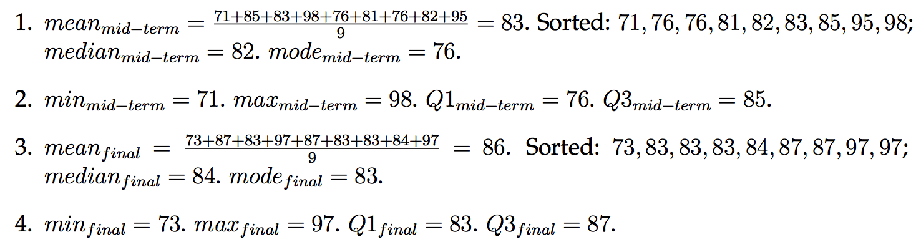
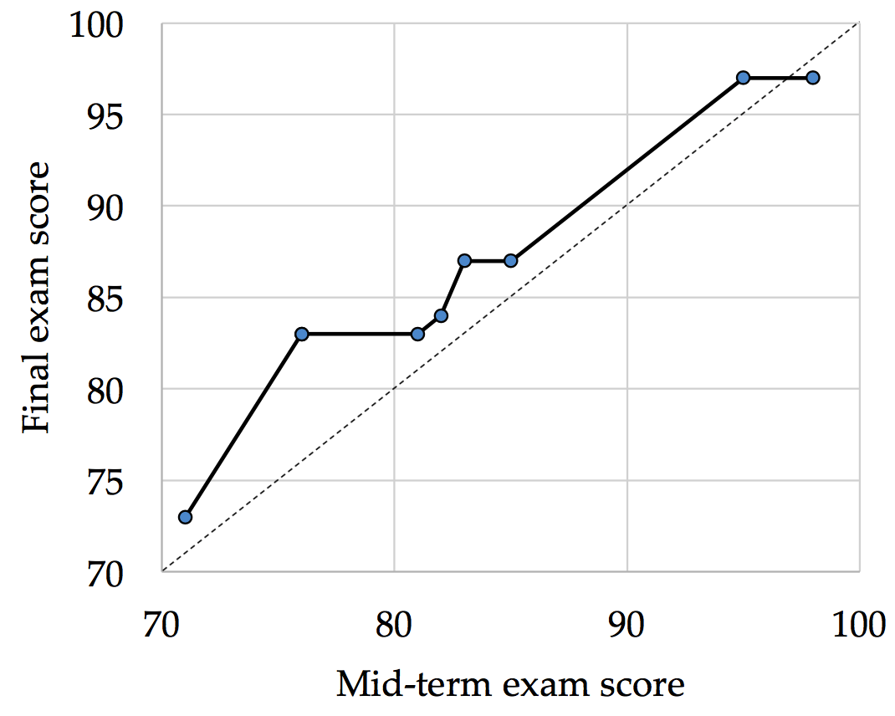
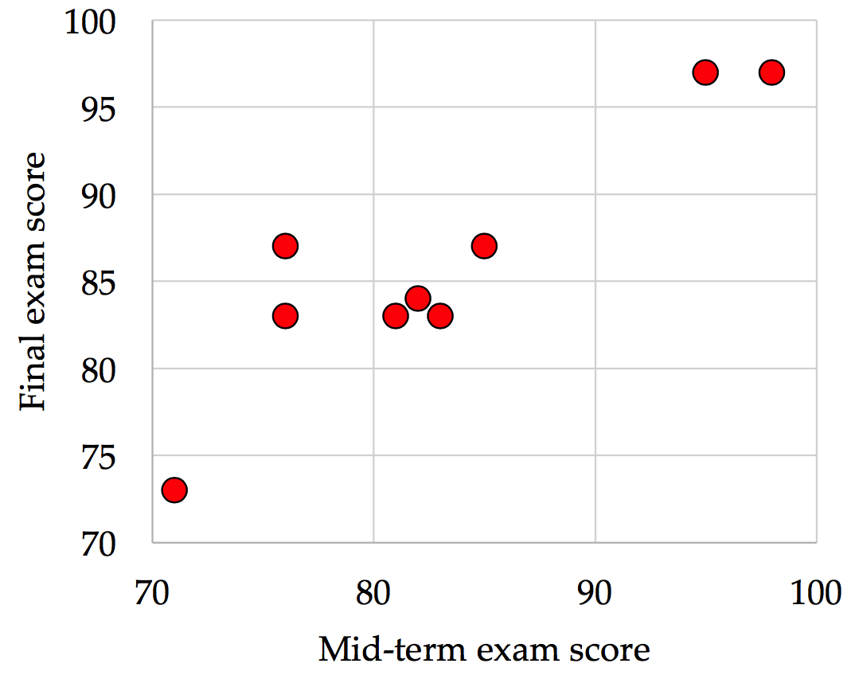
HW1-Q2

Slide 18
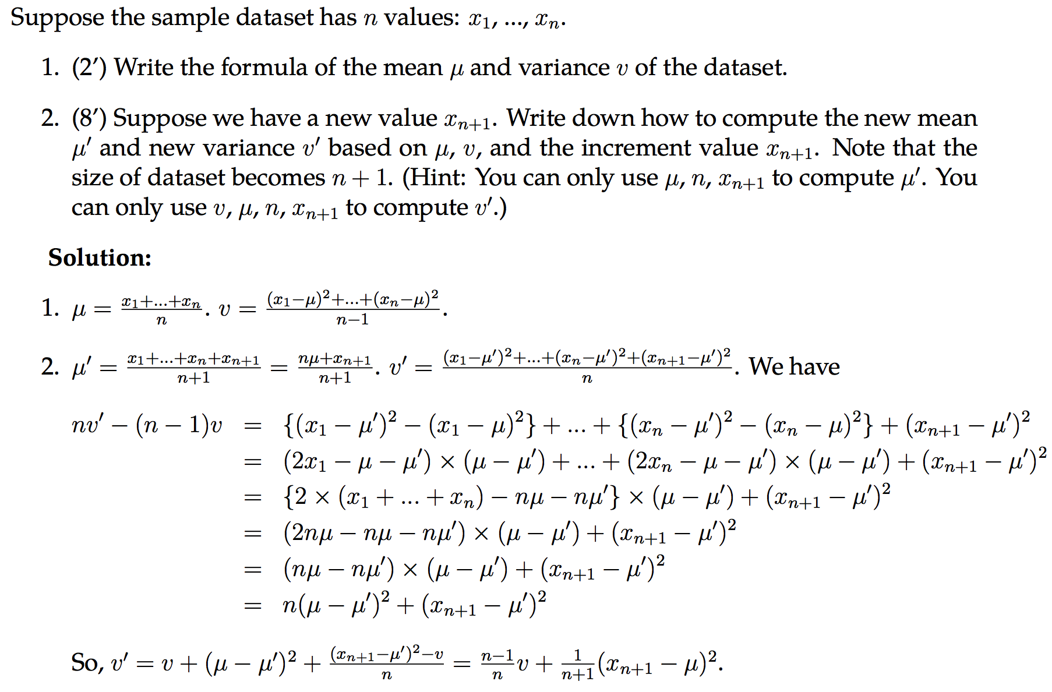
HW1-Q3

Slide 19
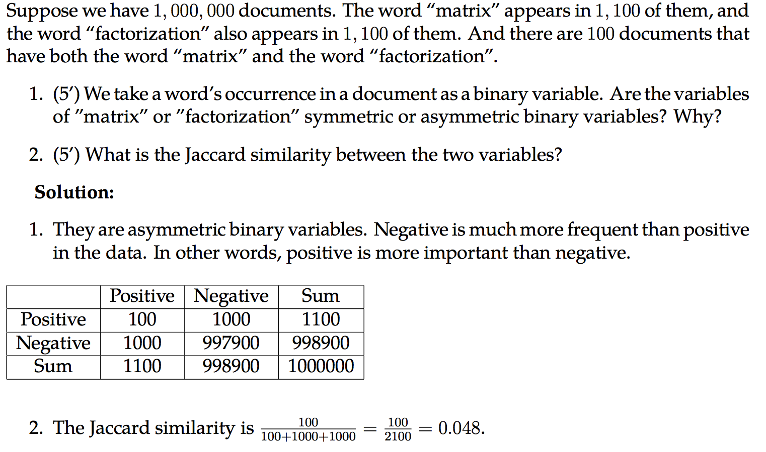
HW1-Q5

Slide 20
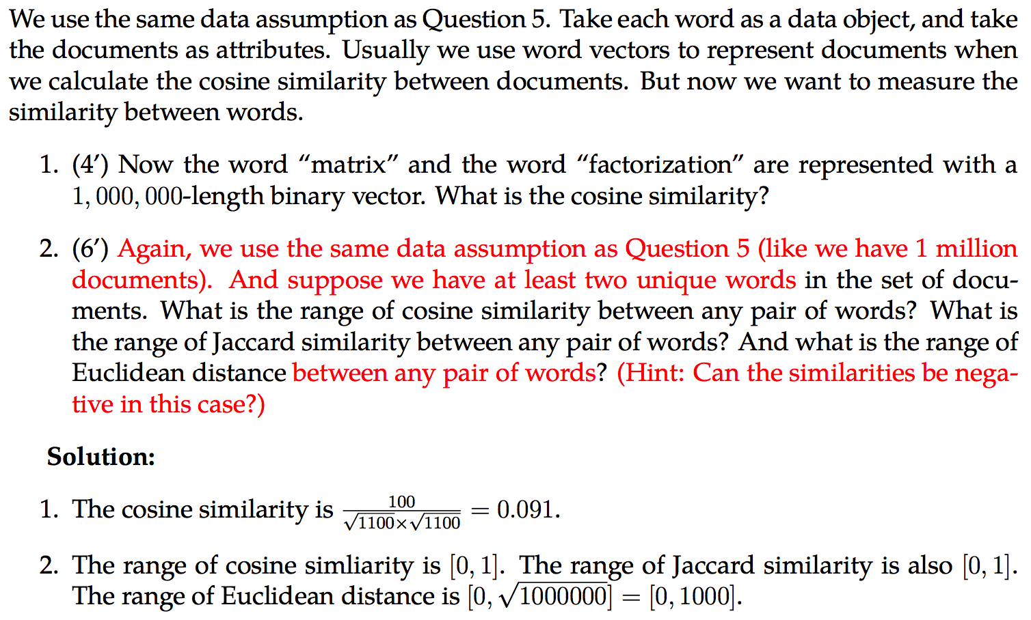
HW1-Q6

Slide 21
Chapter 3: Data Processing
Cleaning, Integration, Reduction

Slide 22
Cleaning and Integration
Incomplete/missing data (Cleaning)
Global constant, attribute mean, most probable value
Noisy data (Cleaning)
Binning, regression, outlier detection, clustering, semi-supervised
Redundancy data (Integration)
Correlation analysis
Categorical attributes → Chi-square test: Null hypothesis, calculation
Numerical attributes → Covariance analysis: Positive, negative, independence, rho, covariance matrix

Slide 23
Reduction
Data reduction
Parametric: Regression, log-liner models
Non-parametric: Histogram, clustering, (stratified) sampling
Min-max/Z-score/Decimal-scaling normalization
Dimension reduction
“Curse of dimensionality”
Feature selection
Attribute subset selection
Feature extraction
Principal Component Analysis (PCA): Eigenvalue, Eigenvectors

Slide 24
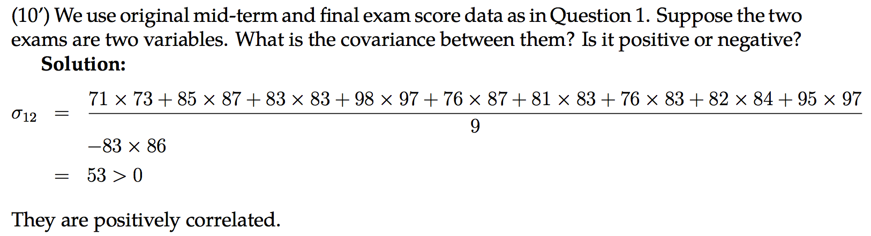
HW1-Q7

Slide 25
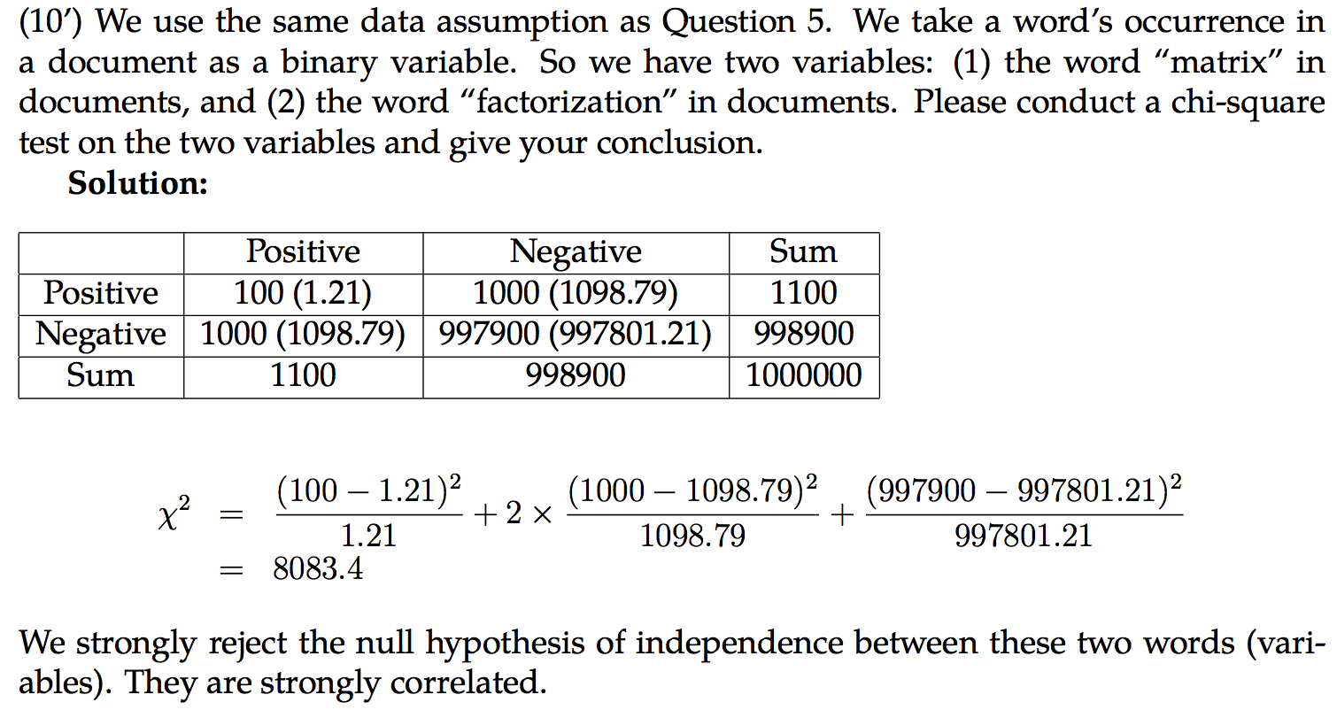
HW1-Q8

Slide 26
Chapter 4: Data Cube
Concepts

Slide 27
Data Cube
Concepts
Cell, Cuboid, Cube
Dimension Value, Dimension Level, Dimension
Components
Dimension tables and Fact tables
Concept hierarchy and Measures
Schemas: What are they?
Operations: What are they?
Materialization: What are they?

Slide 28
Iceberg Cube
Iceberg condition: min_sup (count)
Assumption: “If the base cuboid has only the following base cells:…”
Constraints
Iceberg cells, Non-empty cells, iceberg cube
Base/Aggregate cells/cuboids
Closed cells and closed cube

Slide 29
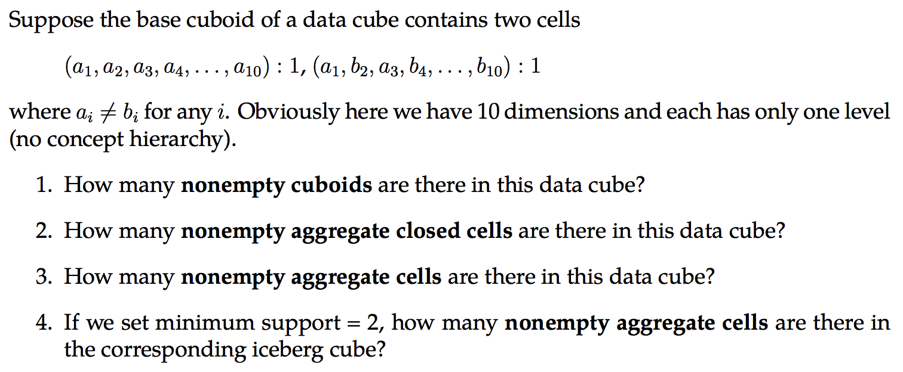
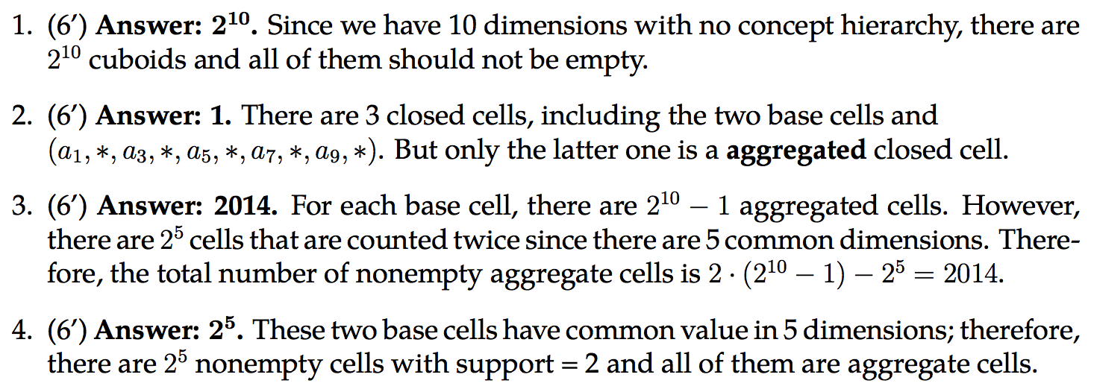
HW2-Q1

Slide 30
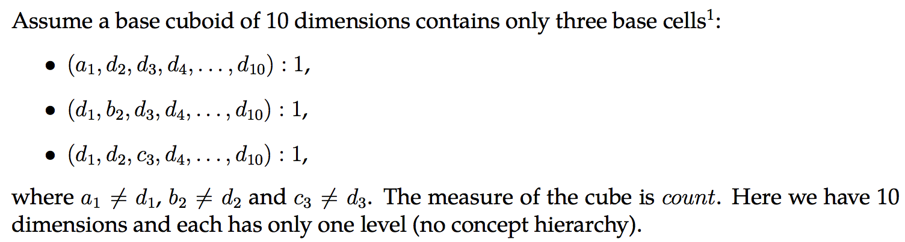
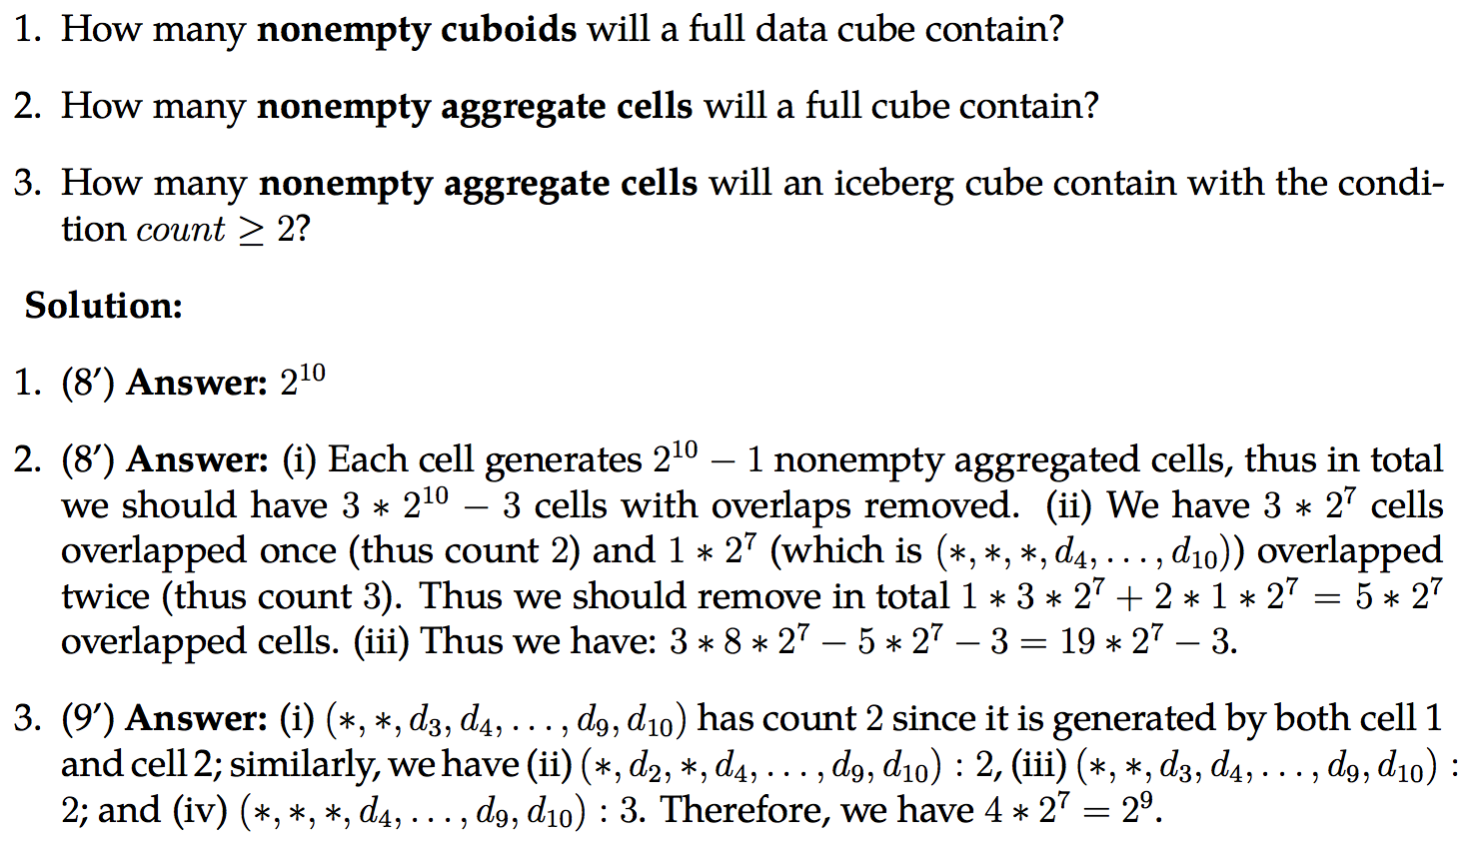
HW2-Q3

Slide 31
Chapter 5: Cube Computation, Data Warehouse and OLAP
Concepts, Algorithms

Slide 32
Cube Computation
Multi-way array aggregation (× Apriori property for iceberg cube; × high dimensionality)
ABC to {AB, AC, BC}: How?
BUC (√ Apriori property for iceberg cube; × high dimensionality)
Shell-fragment (√ For high dimensionality)

Slide 33
Data Warehouse and OLAP
“A data warehouse is a subject-oriented, integrated, time-variant, and nonvolatile collection of data in support of management’s decision-making process.”

Slide 34
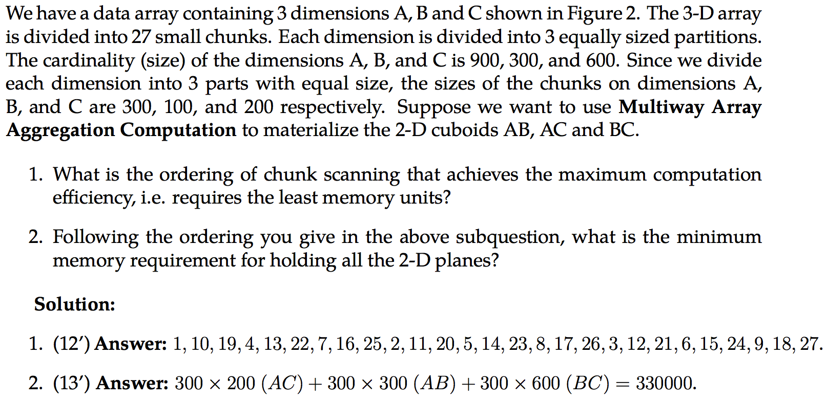
HW2-Q4

Slide 35
Chapter 6: Frequent Pattern Mining
Apriori, FP-Growth and Evaluation

Slide 36
Concepts
Itemset, k-itemset, frequent k-itemset
Absolute/relative support
Association: support and confidence
Closed pattern, Max pattern (lossy)
Apriori property: Any subset of a frequent itemset must be frequent. If any subset of an itemset S is infrequent, then there is no chance for S to be frequent—why do we even have to consider S?!

Slide 37
Apriori
Outline of Apriori (level-wise, candidate generation and test)
Initially, scan DB once to get frequent 1-itemset
Repeat
Generate length-(k+1) candidate itemsets from length-k frequent itemsets
Test the candidates against DB to find frequent (k+1)-itemsets
Set k := k +1
Until no frequent or candidate set can be generated
Return all the frequent itemsets derived

Slide 38
FP-Growth
Idea: Frequent pattern growth (FPGrowth)
Find frequent single items and partition the database based on each such item
Recursively grow frequent patterns by doing the above for each partitioned database (also called conditional database)
To facilitate efficient processing, an efficient data structure, FP-tree, can be constructed
Mining becomes
Recursively construct and mine (conditional) FP-trees
Until the resulting FP-tree is empty, or until it contains only one path—single path will generate all the combinations of its sub-paths, each of which is a frequent pattern

Slide 39
Try WikiBooks’ Example
https://en.wikibooks.org/wiki/Data_Mining_Algorithms_In_R/Frequent_Pattern_Mining/The_FP-Growth_Algorithm

Slide 40
Pattern Evaluation
Interestingness Measures
Subjective
Objective
Support, confidence
Null-variant
Lift: symmetric
Chi-square test
Null-Invariance
AllConf
Jaccard, Cosine
Kulc, MaxConf + Imbalance Ratio

Slide 41
Chapter 7: Advanced Frequent Pattern Mining
Diverse Patterns
Sequential Patterns
Graph Patterns

Slide 42
Concepts
Diverse Patterns
Multiple-Level Associations
Multi-Dimensional Associations
Quantitative Associations
Negative Correlated Patterns
Pattern | Closed Pattern (Concepts) | Idea 1: Pattern candidate generation and pruning | Idea 2: Pattern growth
Frequent pattern (itemset) | Closed frequent itemset | Apriori (1994) | FP-Growth (2000)
Sequential pattern | Closed seq. pattern | GSP (1996) | PrefixSpan (2004)
Graph pattern | Closed graph pattern | FSG (2000-2001) | gSpan (2002)

Slide 43


Mid-term exam:
Oct. 5th (Thursday)
2:00 p.m. – 3:15 p.m. (75 minutes)
In class
Take a pen!!!
You are only allowed to have an A4-size paper double-sided for reference.
I believe you can write a lot a lot on it…

Slide 44
Alan Time
If no one is answering, maybe he/she is behind you ❤

